Slide 1
Implementing Blockchains for Efficient Health Care
SACHIN SOMANNA 1NT17IS144
PAVAN KULKARNI 1NT18IS410

Slide 2
BACKGROUND:
The decentralized nature of sensitive health information can bring about situations
where timely information is unavailable,
worsening health outcomes.
Furthermore, as patient involvement in health care increases,
There is a growing need for patients to access and control their data.
Blockchain is a secure, decentralized online ledger that could be
used to manage electronic health records (EHRs) efficiently.
Therefore with the potential to improve health outcomes
by creating a conduit for interoperability.

Slide 3
OBJECTIVE
This study aimed to perform a systematic review to assess the feasibility
of blockchain as a method of managing health care records efficiently.
METHODS
Reviewers identified studies via systematic searches of databases including PubMed, MEDLINE, Scopus, EMBASE, ProQuest, and Cochrane Library.
Suitability for inclusion of each was assessed independently.

Slide 4
INTRODUCTION
Medical records in Britain comprise of legacy paper records and numerous disconnected electronic systems.
Despite the advancement of other health care fields such as oncology and neurology in their use of technology ,
there remains a lack of interoperability in health care systems , arising from the nonuniform record storage methods,
that restricts doctors in their capacity to provide appropriate care.
Furthermore, the lack of (correct) information has been considered the primary cause of problems in health care, leading to medical errors and adverse events.
National Health Service(NHS)
Blockchain could solve the problem of interoperability by allowing doctors to gather information about a patient from multiple independent systems.

Slide 5
What is Blockchain?
A blockchain is a decentralized online ledger (database), first implemented to store an ever-increasing record of all transactions using the cryptocurrency, Bitcoin .
It works by replacing trusted third-party signatories of a transaction
with computational (cryptographic) proof to validate transactions.
This validation is carried out by a network of users (“full nodes”) who collectively adhere to previously agreed rules, which are implemented by the software.
It saves both cost of mediation and cost for reversing a transaction .

Slide 6
The transaction records are grouped into blocks, each of which is locked to the next with a cryptographic hash.
The system is also flexible enough to allow the addition of arbitrary logic to process, validate, and access the data.
This is implemented via components of business logic known as smart contracts, which reside on the blockchain and are synchronized across all nodes.
The ability to create smart contracts makes blockchain suitable for health care, where strict regulations govern how sensitive data can be used .
Information exchange using smart contracts is transparent and conflict-free and eliminates the need for a middleman, as the blockchain executes the data sharing based on the preagreed conditions of the contract

Slide 7
Ownership and privacy of data are important issues that blockchain could solve. It is currently debated whether the health care provider or the patient owns health care data relating to a patient (although patients have a definite right to access the data
Another concern with medical records is the cost currently associated with transferring records between locations
The aim of this review was to summarize the evidence relating to the
implementation of blockchains to manage electronic health records (EHRs),
and to discuss whether this would improve efficiency of record management.

Slide 8
Methods
The review protocol was used with the following modifications:
The research question was narrowed to focus on efficiency,as the issues of privacy and scalability would broaden the review excessively
(2) A total of 5 additional search databases were included to account for the potential lack of published research on the topic, and
(3) The population was extended to anyone whose health data are stored in a blockchain.

Slide 9
Strategies to implement Blockchain
Medical record: record consisting of information about the physical or mental health or
condition of an identifiable individual made by or on behalf of a health professional in
connection with the care of that individual .
Efficiency: Either improved interoperability or cost-effectiveness, or improved health
outcomes as a result of these.
Current methods: These may consist of traditional paper-based methods or more advanced
technology adopted to provide more coordinated health care.
Interoperability: Automatic and seamless exchange of health information across health
information systems .(This corresponds to syntactic interoperability.)

Slide 10
Search Strategy and Study Selection
The primary outcome measures were interoperability and cost-effectiveness .
The secondary outcome measure was improved health outcomes,
although it was noted that it might be difficult to determine a quantitative
measure of this with respect to blockchains.

Slide 11
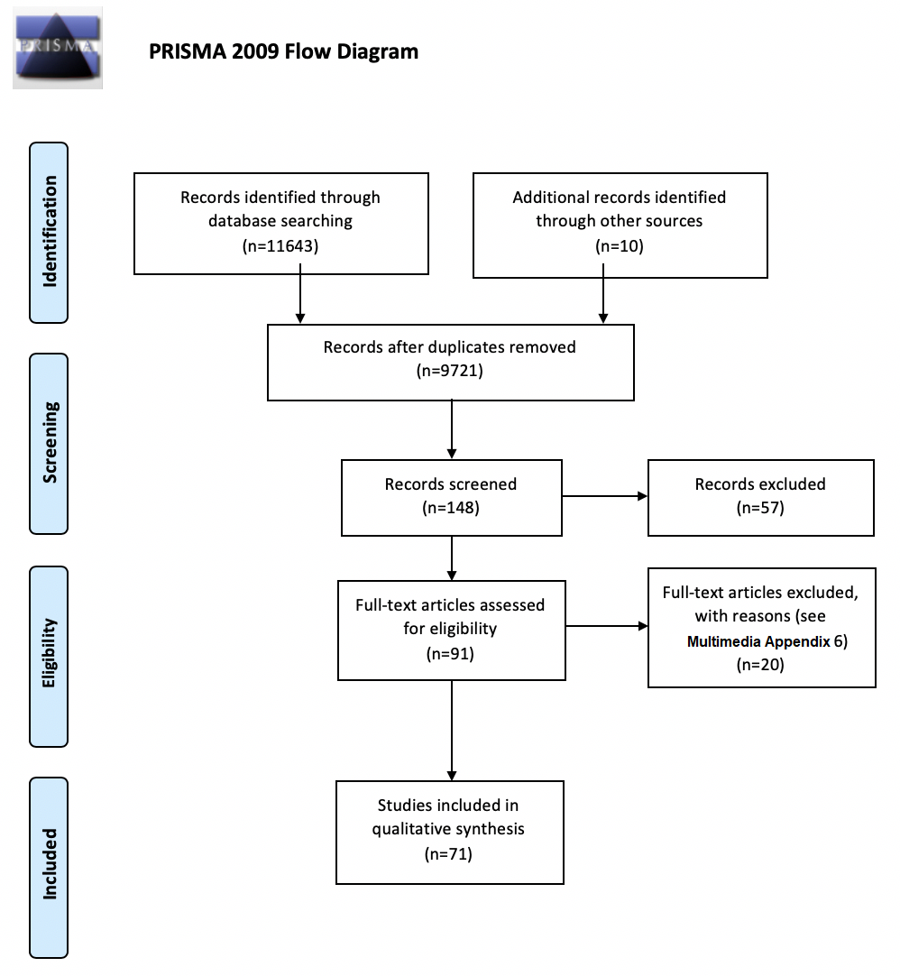

Slide 12
Results
Few studies described the implementation of a blockchain system to real-world medical data,
highlighting the novelty of this technique.
Interoperability, one of our primary outcome measures, was seen as feasible using a blockchain approach to store an index of records and to manage access to cloud-based records .
This approach saves the administrative costs involved in transporting records, as well as the medical costs associated with waiting for their arrival.
Logistical difficulties and costs may arise in collating legacy data, although we expect that these would be accounted for in savings from improved health outcomes in the long term.

Slide 13
Challenges and Limitations
Data Ownership and Privacy
Achieving interoperability depends on patients taking control of their data and
deciding on how it is to be used, features integral to blockchain.
Legal
Under GDPR (Article 17), the Organization of Economic Cooperation and Development privacy guideline,
the Health Insurance Portability and Accountability Act (HIPAA) Privacy Rule, and others ,
individuals may request for their data to be erased.
This is possible when the records themselves are not stored on the blockchain.
Security
Sensitive data must be kept safe from eavesdroppers and intruders .
Breaches have a negative impact on the public perception of the health care field and
threaten to hinder future research through more stringent regulatory restrictions

Slide 14
conclusions
The storage and sharing of medical data (developing interoperability) are vital for improved health outcomes.
Respecting privacy of sensitive information while doing this remains a big challenge in health care.
The literature shows that with the appropriate regulatory guidelines and use standards,
blockchain can act as a vehicle to manage consented access to EHRs.
This will increase interoperability without compromising security, while also protecting patient privacy.

Slide 15
These issues would most effectively be tackled by the use of a private or consortium-led blockchain.
The improved interoperability and reduced long-term administrative costs would lead to improved health outcomes.
Although this technology is currently unfamiliar to most, investments into creating a sufficiently user-friendly interface and educating users on how best to take advantage of it would lead to improved health outcomes.

